Slide 1
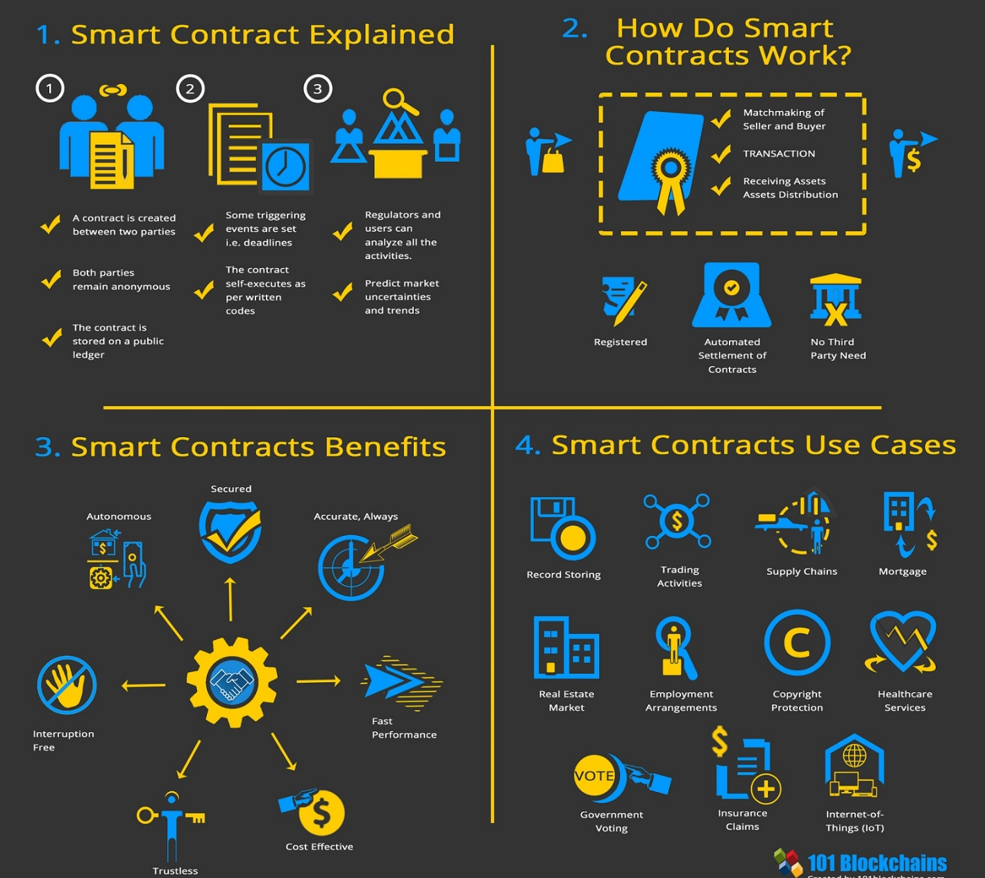
Smart Contracts
A smart contract is a self-executing contract with the terms of the agreement between buyer and seller being directly written into lines of code.
Code and the agreements contained therein exist across a distributed, decentralized blockchain network.
The code controls the execution, and transactions are trackable and irreversible.
Smart contracts permit trusted transactions and agreements to be carried out among disparate, anonymous parties without the need for a central authority, legal system, or external enforcement mechanism.
06

Slide 2
Smart Contracts
Features
Intermediaries, Automation and Time Savings
The sheer number of middlemen and intermediate layers involved in the execution of a traditional contract slows the process, often taking days or even weeks.
Security
Privacy and security are concerns with traditional contracts. With so many intermediate parties involved, security can be compromised at any stage in the process.
Accuracy and Transparency
Terms and conditions are predefined and pre-embedded in a smart contract. As soon as a condition is met, remittance occurs automatically and is recorded.
Cost
Traditional contracts are expensive when compared to smart contracts simply because all those middlemen must be paid.
06

Slide 3
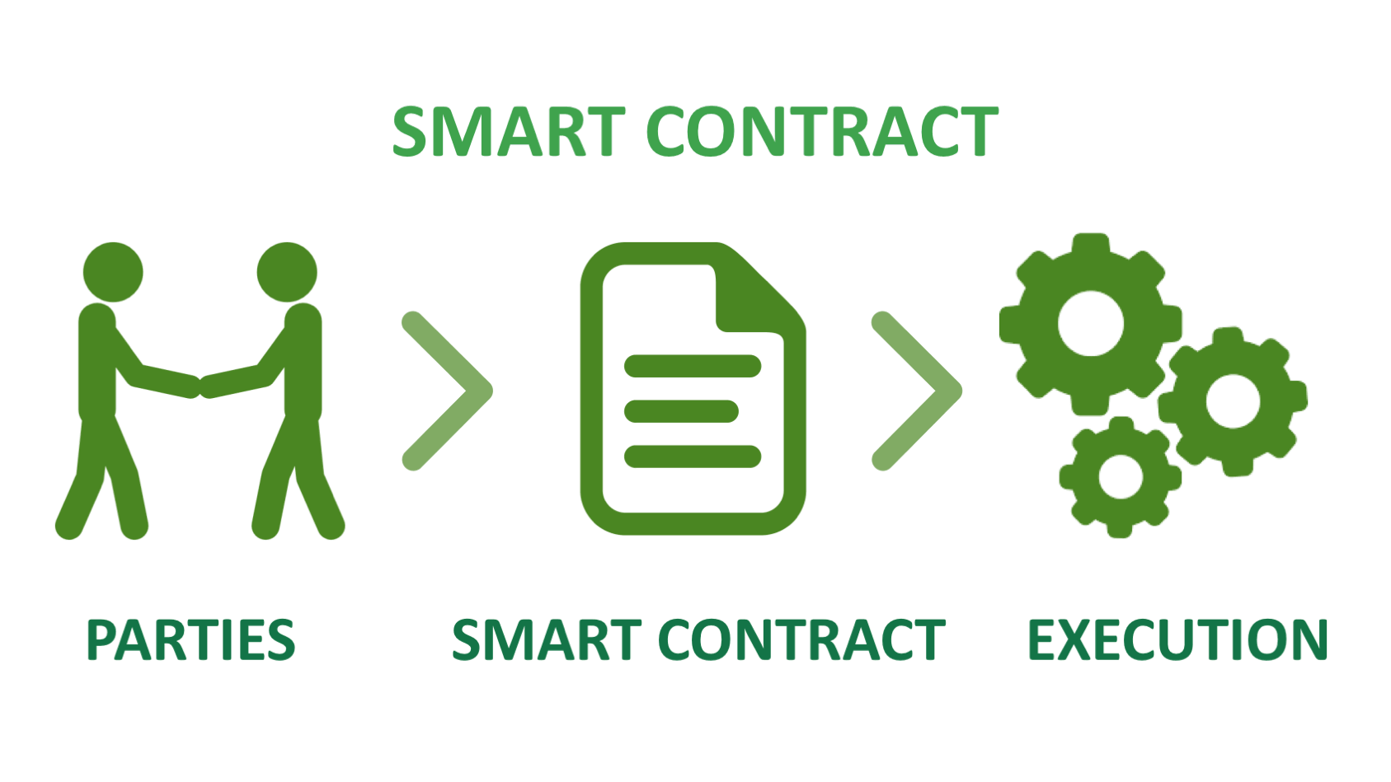
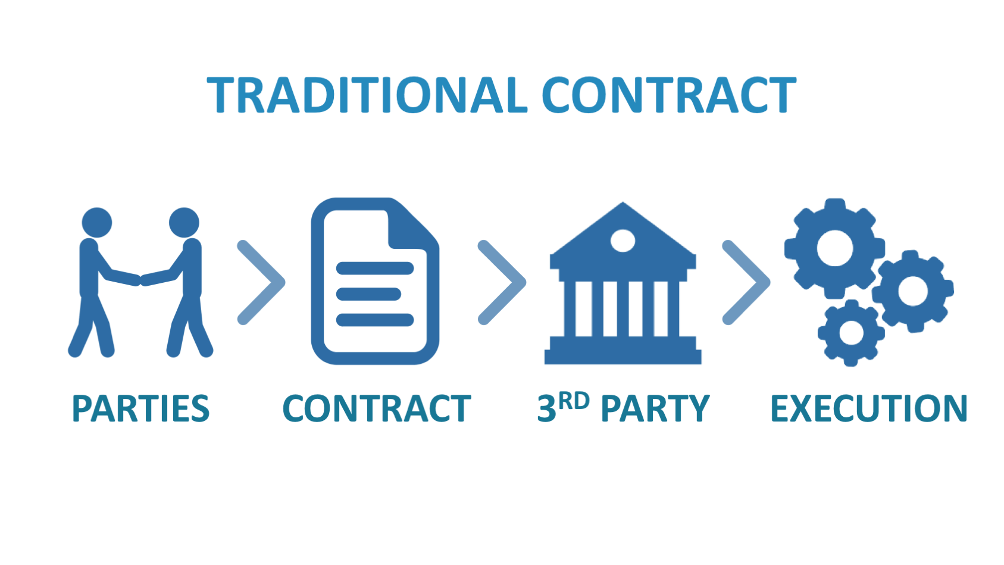
Difference Between Traditional Contracts and Smart Contracts
 | Traditional Contract | Smart Contract
Third Party | Government, Lawyers, etc. | None
Execution Time | 1-3 days | Minutes
Remmittance | Manual Process | Automatic Process
Transparency | Unavailable | Available
Archiving | Difficult | Easy
Security | Limited | Cryptographically Secure
Cost | Expensive | Cheap
Signature | Manual Process | Digital Signature
06

Slide 4
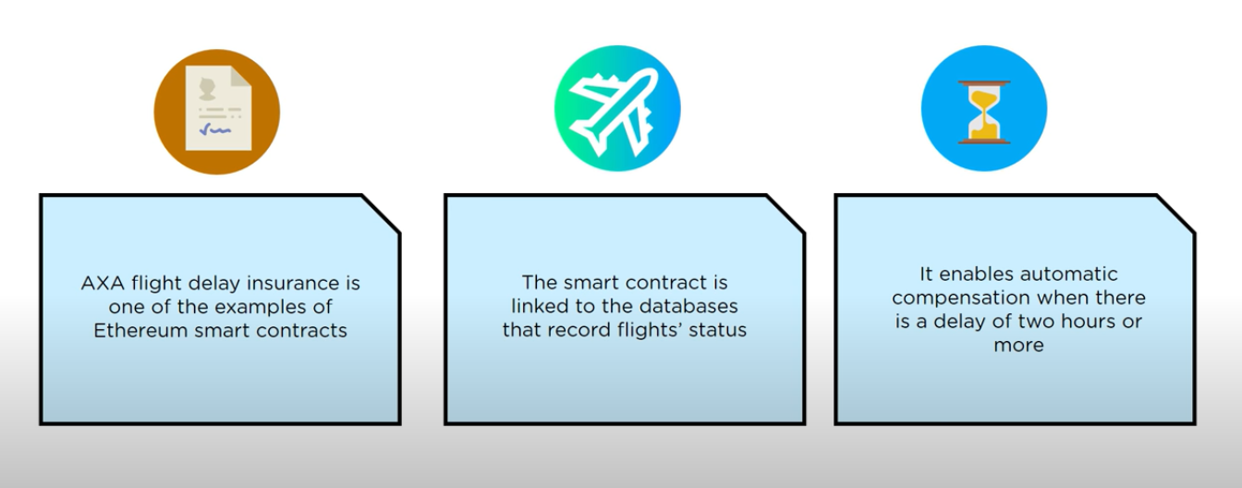
Smart Contracts
06

Slide 5
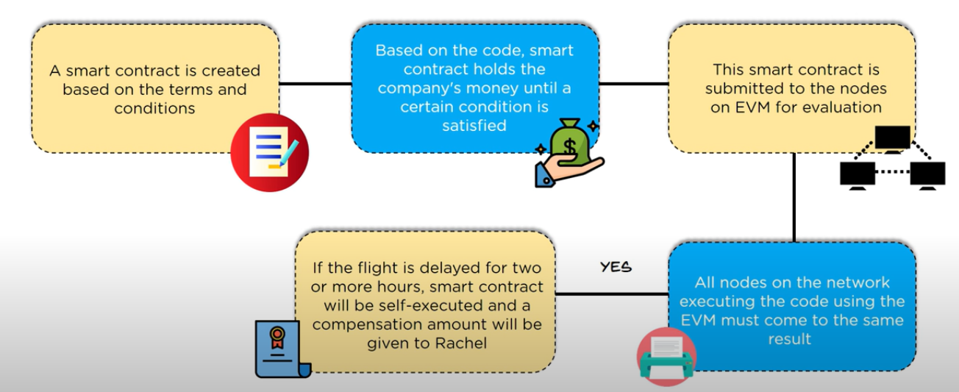
Smart Contracts
06

Slide 6
Smart Contracts
Example of Smart Contracts
Suppose you rent an apartment from me. You can do this through the blockchain by paying in cryptocurrency.
You get a receipt which is held in our virtual contract; I give you the digital entry key which comes to you by a specified date.
If the key doesn’t come on time, the blockchain releases a refund. If I send the key before the rental date, the function holds it releasing both the fee and key to you and me respectively when the date arrives.
The system works on the If-Then premise and is witnessed by hundreds of people, so you can expect a faultless delivery. If I give you the key, I’m sure to be paid.
If you send a certain amount in bitcoins, you receive the key. The document is automatically canceled after the time, and the code cannot be interfered with either of us without the other knowing since all participants are simultaneously alerted.
06

Slide 7
Solidity
Uses of Smart Contracts
Management
Real Estate
Healthcare
Trade finance
Property ownership
Mortgages
Insurance
Voting
Product development
Stocktaking
06

Slide 8

Solidity
Solidity is an object-oriented, high-level language for implementing smart contracts. Smart contracts are programs which govern the behaviour of accounts within the Ethereum state.
Solidity was influenced by C++, Python and JavaScript and is designed to target the Ethereum Virtual Machine (EVM).
It is statically typed, supports inheritance, libraries and complex user-defined types among other features.
With Solidity you can create contracts for uses such as voting, crowdfunding, blind auctions, and multi-signature wallets.
06

Slide 9
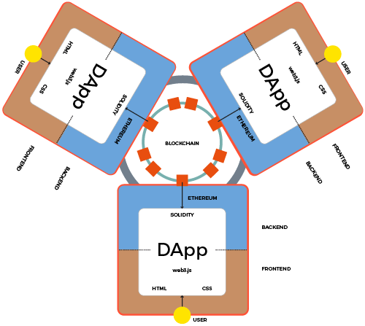
Decentralized Applications
D-apps is an interface for people to connect with application.
It contains an interface for people to interact with something on the block chain.
DAP consists of a front end and a back end which is the smart concept.
06

Slide 10
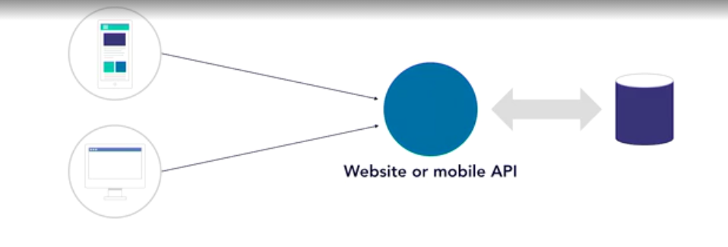
Todays Apps
06

Slide 11
Problems with Todays Apps
Ddos Vulnerability
Trust, Fees, and Data to “Middle Man”
Transactions and Data hidden and proprietary
Cases: Uber, Airbnb, Facebook
06

Slide 12
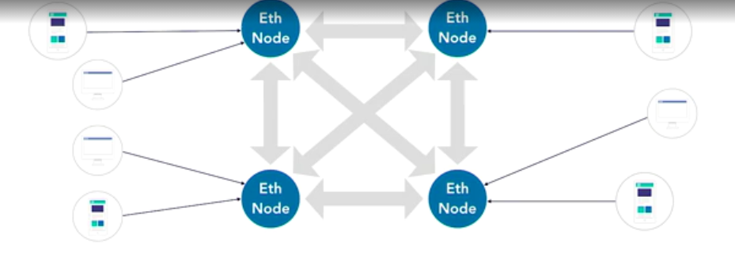
Advantages of Dapps
06
Reduces Fees
Reduces reliance on central resource
Ddos-free
Remove Personal trust from the transaction

Slide 13
Types of Dapps
Tokens
Convert Assests to cryptoassets.
Vote
Reward
Transactions and Financial
Other
06

Slide 14
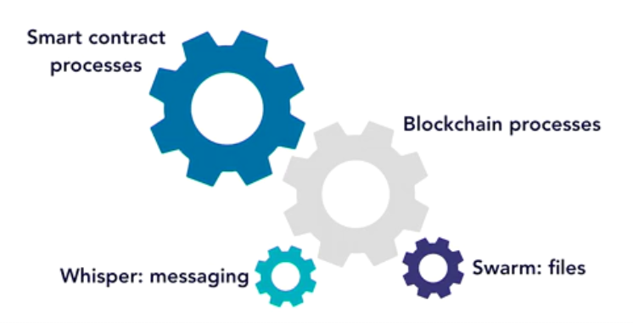
How Ethereum Works?
Ethereum is a blockchain that is in many ways like Bitcoin meaning anyone can download it and run the blockchain processing software and even download a full node which contains all the the blocks of the blockchain.
The heart of Ethereum's power is this EVM.
The EVM is co-located with the full Ethereum blockchain so anyone who downloads and runs a node will also by default be running the EVM.
EVM is a runtime engine that processes smart contracts.
No inherent network access, file system access, or other processes.
Limited Access to other contracts.
Smart contracts stored in bytecode in blockchain.
Contracts are written in solidity, but other options exist.
06

Slide 15
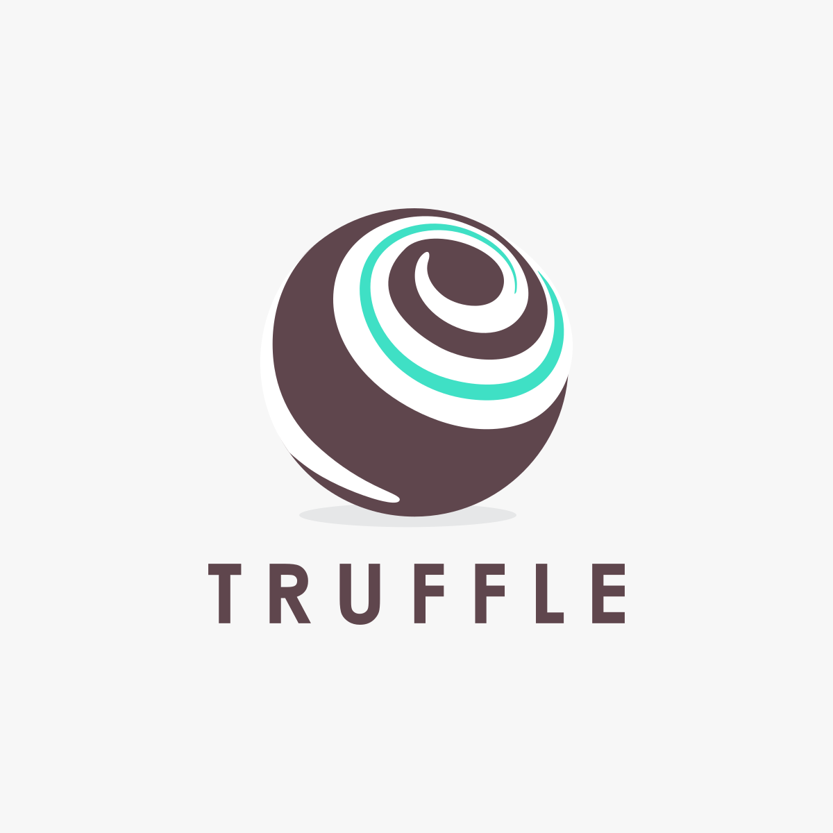
Truffle Suite
Truffle is a development environment, testing framework and deployment pipeline for Ethereum dapps — or any blockchain using the EVM.
Operated in terminal.
Based on Ethereum Blockchain and is designed to facilitate the smooth and seamless development of DApps (Distributed Applications).
It comprises of 3 elements-
Truffle
Ganache
Drizzle
06

